Slide 1
Oct 11, 2018
Automated ML in Azure
New York Azure ML Meetup
MSFTGUEST
msevent188su

Slide 2
Agenda
General Updates
Infer.net released as opens source
https://dotnet.github.io/infer/userguide/Infer.NET%20tutorials%20and%20examples.html
Infer.net has been used extensively to create novel algorithms by Microsoft Research
https://www.microsoft.com/en-us/research/blog/the-microsoft-infer-net-machine-learning-framework-goes-open-source/?ocid=msr_blog_infernet_hero
Sentiment Analysis Demo updated and posted to github (confirmed – the developer (me) made an error)
Automated ML service from Azure Machine Learning Services

Slide 3
Infer.net probabilistic model
Variable<bool> firstCoin = Variable.Bernoulli(0.5);
Variable<bool> secondCoin = Variable.Bernoulli(0.5);
Variable<bool> bothHeads = firstCoin & secondCoin;
InferenceEngine ie = new InferenceEngine();
Console.WriteLine("Probability both coins are heads: "+ie.Infer(bothHeads));
Probability both coins are heads: Bernoulli(0.25)

Slide 4
Automated Machine Learning & Hyperparameter Tuning in Azure Machine Learning service
BRK3332
Oct 2018 NY Azure ML Meetup
Much of the deck taken from Ignite 2018 Conference

Slide 5
Why do we need automated machine learning (real quotes from customers)
“I manually built a model for one substation and it took several weeks, but there are 1000s of substations that I need to build models for”
“I am finding myself tweaking algorithms and parameters for a long time. Its hard for me to find “good enough” place to stop”
“I spent 4 weeks using SVM algorithm for my dataset only to realize SVM doesn’t work”

Slide 6
Quick Background – Azure ML Services?
Next Generation of general purpose – end to end – machine learning framework from Microsoft
End to end – means from data to model to deployment/production
Initial focus on python as the common programming language, scikit-learn and several deep learning frameworks
Provides a collaboration space(workspace), and tracking engine hosted in Azure
Support local (desktop,), remote (cloud VM), or notebook hosted development
Handles packaging of model, configuration, and details to deploy locally or remotely to Kubernetes, Databricks…
Not a GUI – pick the IDE of your choice for python and libraries
Invoke via tools or CLI
Includes automated ML preview bits …

Slide 7







Azure Machine Learning Services Overview
Prepare
Experiment
Deploy
…
Prepare Data
Build model (your favorite IDE)
Train & Test Model
Register and Manage Model
Build Image
Deploy Service
Monitor Model

Slide 8




Azure ML
Workspace
1. Snapshot folder and
send to experiment
2. Create docker image
6. Stream stdout, logs, metrics
Experiment
Docker Image
5. Launch script
6. Stream stdout, logs, metrics
3. Deploy docker and snapshot to compute
7. Copy over outputs
Compute Target
4. Mount datastore to compute
Data Store
My Computer

Slide 9
What do you get out of this Automated ML session?
Basics of Machine Learning
What is Automated ML
Build a ML model using Automated ML

Slide 10

Machine Learning Model Building
Dataset
Model Training
Infrastructure
Training Algorithm
Model
Model 2
Model 1
Hyperparameters

Slide 11
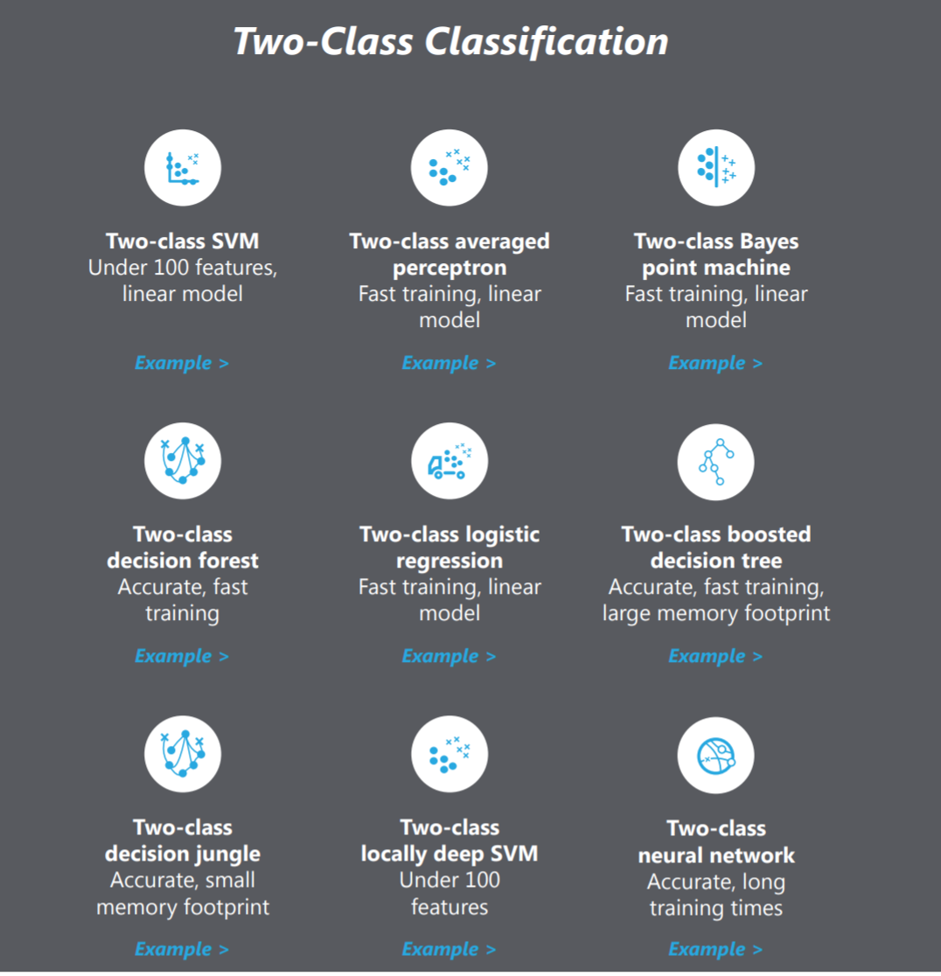
Algorithms – Sample Binary Classification Algorithms
Algorithm Choice –
Many to choose from

Slide 12
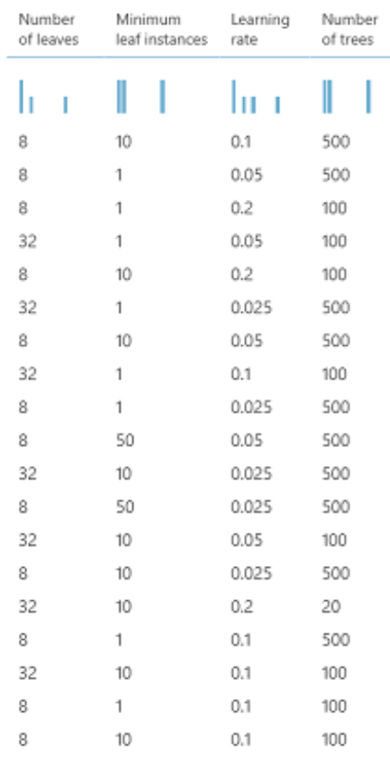
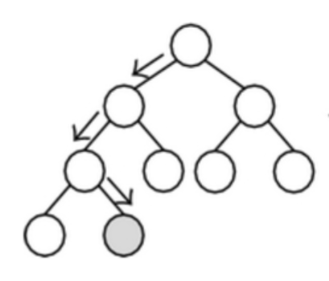
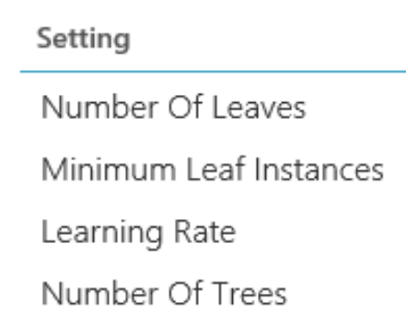
Hyperparameters

Slide 13
Typical manual approaches for hyperparameter tuning
Dataset
Model Training
Infrastructure
Training Algorithm 1
Training Algorithm 2
Model 1
Model 2
Model 3
Model 4
Hyperparameter
Values – config 1
Hyperparameter
Values – config 2
Hyperparameter
Values – config 3
Repetitive & Manual
Hyperparameter
Values – config 4

Slide 14
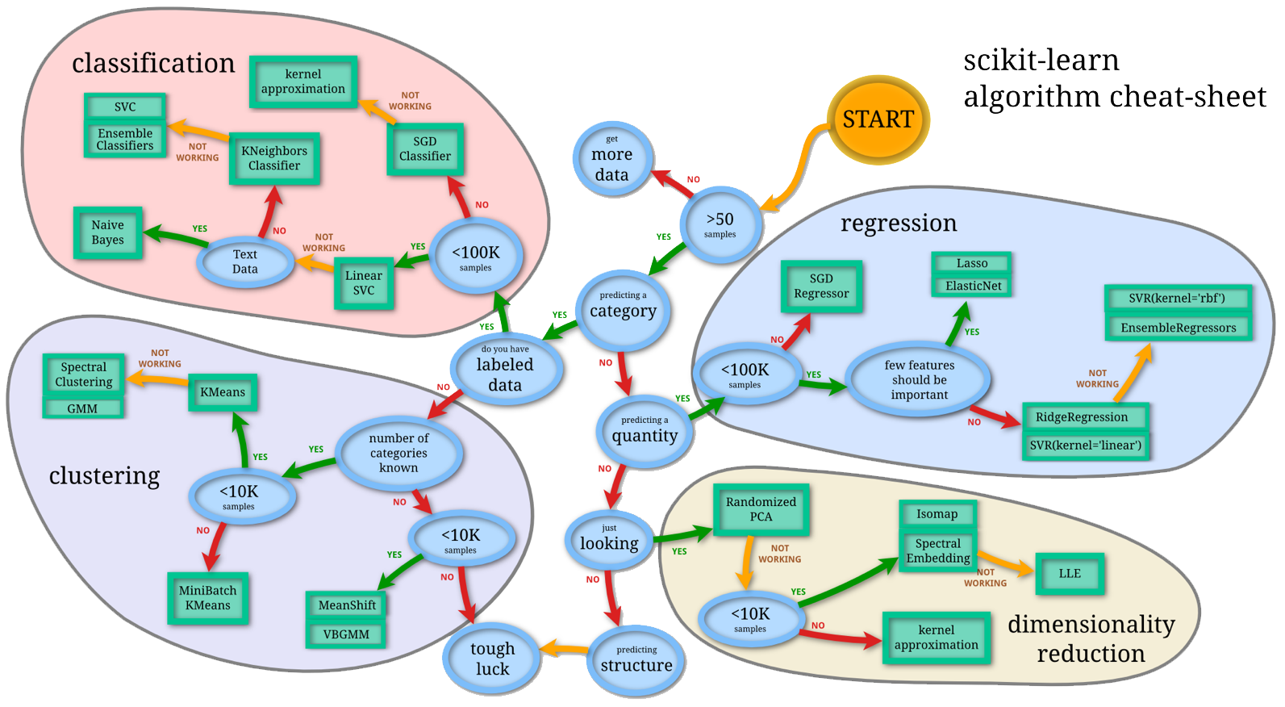
Machine Learning Complexity
Source: http://scikit-learn.org/stable/tutorial/machine_learning_map/index.html
This must get simpler, it simply won’t scale!

Slide 15
Introducing Automated Machine Learning

Slide 16
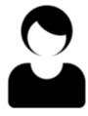
User inputs & system outputs
Configure Automated ML
Data Pre_Process
Budget – Time / Compute
Etc.
Data
Machine Learning Model
Automated ML

Slide 17
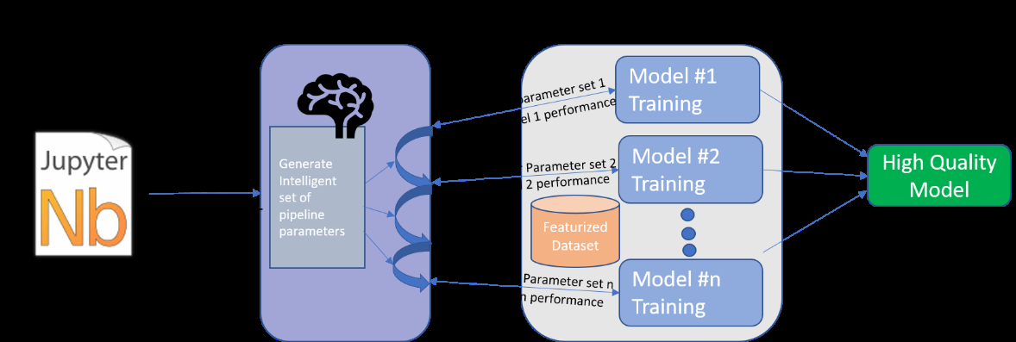
Hyperparameters too

Slide 18

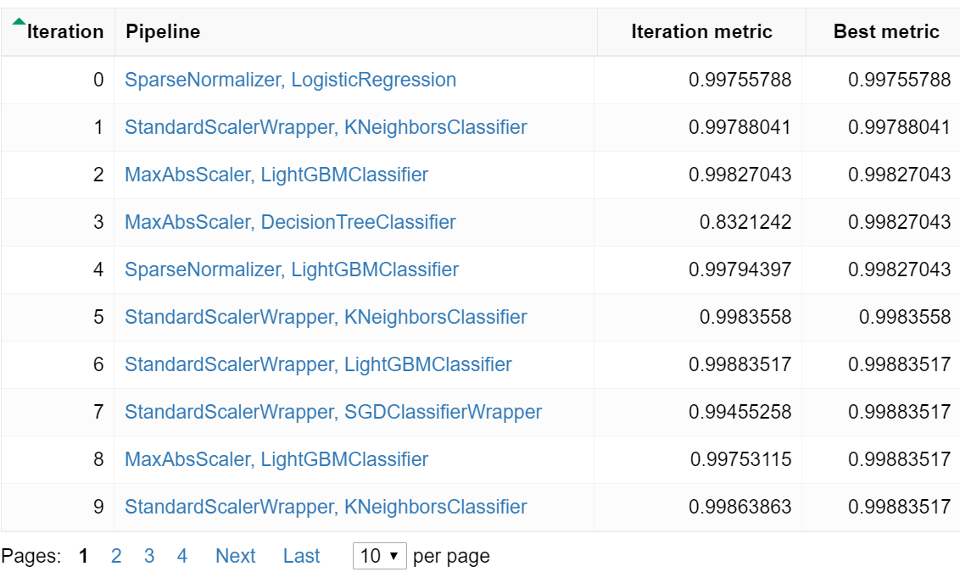


Automated ML – User Experience
Python Script
Automated ML
Models (User Compute – Local or Cloud)
Configuration
Submit
Train
Generate Algorithms & Hyperparameter values
Dataset
Output
High Quality Machine Learning Model

Slide 19
Configuration options available in automated machine learning:
Select your experiment type, e.g., Classification, Regression
Data source, formats, and fetch data
Choose your compute target (local or remote)
Automated ML experiment settings
Run an automated ML experiment
Explore model metrics
Register and deploy model

Slide 20
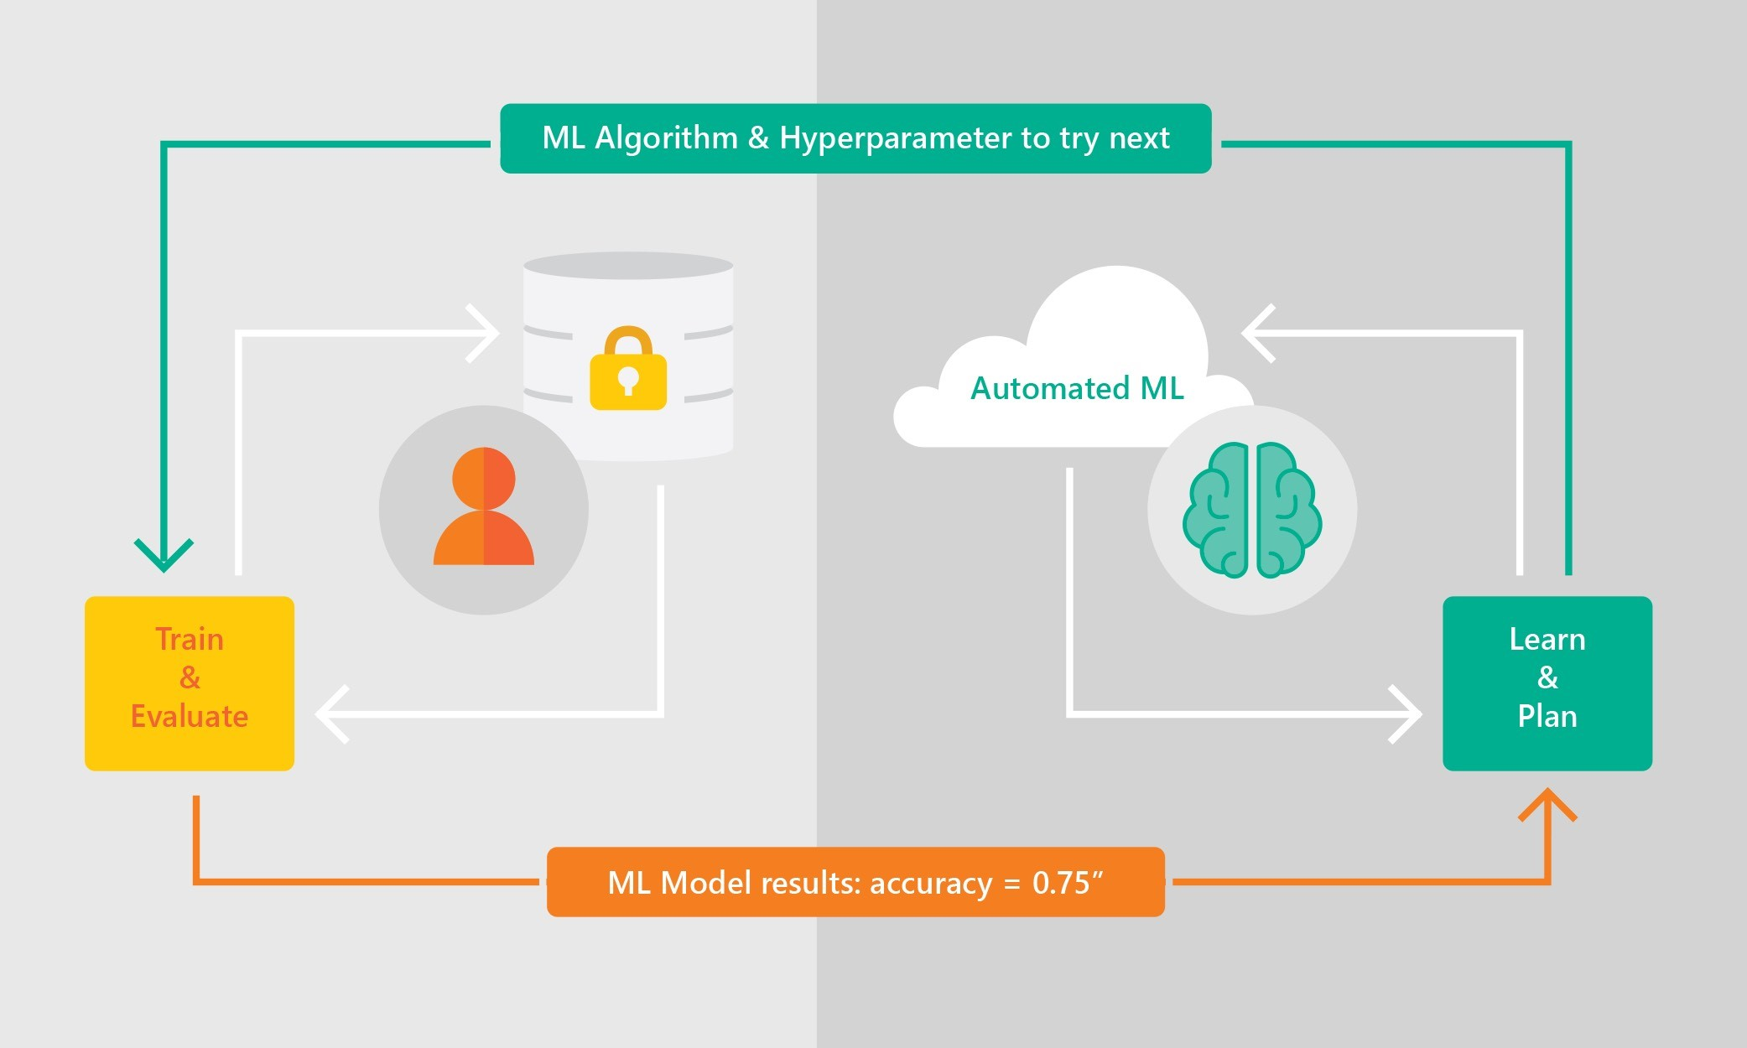
Automated ML – How it works
Based on Microsoft Research
Trained with several million experiments
Collaborative filtering and Bayesian optimization
Privacy preserving: No need to “see” the data

Slide 21
background
Collaborative filtering
often used in recommendation engines based on ratings/feedback on ‘items’ – in this case model accuracy
Bayesian Optimization
In grid and random approaches there is no memory or influence of prior results. Each test is done totally independently.
Automatic tuning uses prior results to influence the next set of hyperparameters with the goals of making smarter choices
Bayesian optimization is one of several techniques that is used to learn from prior results, while not falling into a local sub-optimal result.
An overview can be found at: https://arimo.com/data-science/2016/bayesian-optimization-hyperparameter-tuning/

Slide 22
Demo

Slide 23
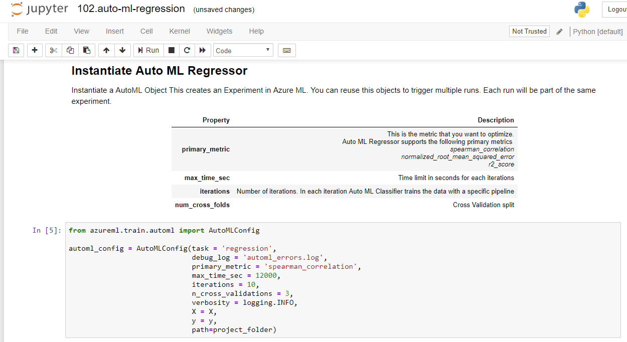
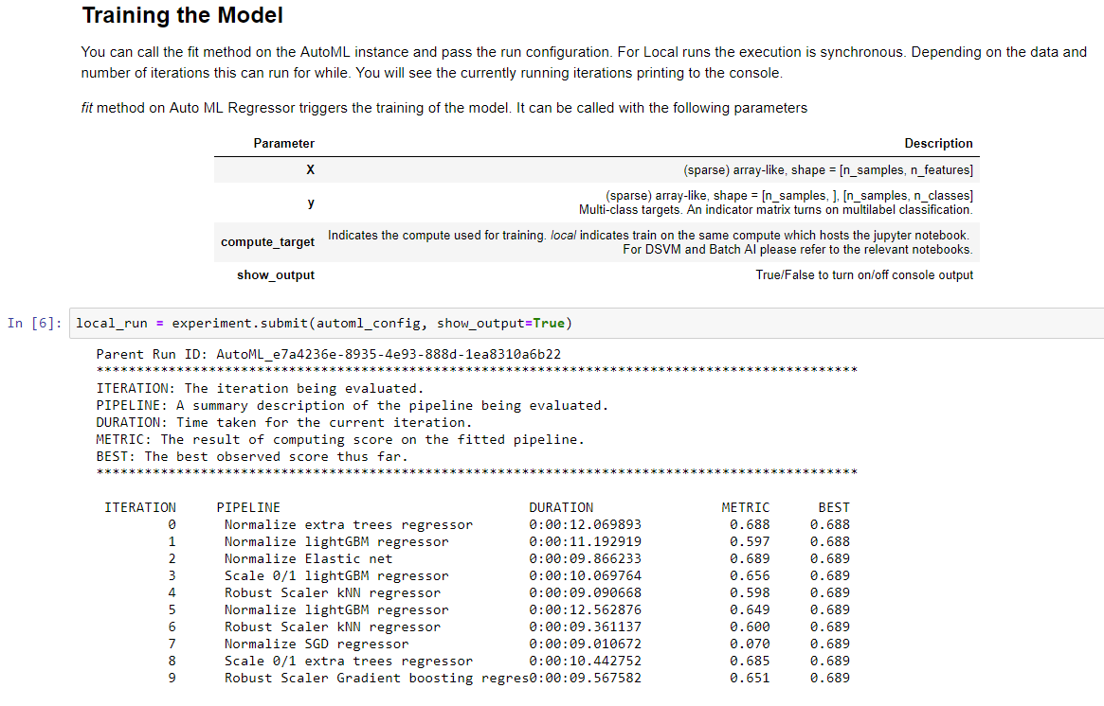
Easy to Use

Slide 24
Automated ML in Power BI (cannot demo this – watch the video from MicrosoftIgnite.com session BRK3332

Slide 25
Automated ML Capabilities
Problem Spaces
Classification
Regression
Frameworks Supported
Scikit-learn
Languages supported
Python
Data Type, Data Sources, Formats & Compute
Numerical & Text
Scikit-learn supported data formats (Numpy, Pandas)
Local Files, Azure Blob Storage, more in future
Local Computer, Cloud Computer (Azure DSVM, Azure Batch AI)

Slide 26
List of models
Classification | Regression
sklearn.linear_model.LogisticRegression | sklearn.linear_model.ElasticNet
sklearn.linear_model.SGDClassifier | sklearn.ensemble.GradientBoostingRegressor
sklearn.naive_bayes.BernoulliNB | sklearn.tree.DecisionTreeRegressor
sklearn.naive_bayes.MultinomialNB | sklearn.neighbors.KNeighborsRegressor
sklearn.svm.SVC | sklearn.linear_model.LassoLars
sklearn.svm.LinearSVC | sklearn.linear_model.SGDRegressor
sklearn.calibration.CalibratedClassifierCV | sklearn.ensemble.RandomForestRegressor
sklearn.neighbors.KNeighborsClassifier | sklearn.ensemble.ExtraTreesRegressor
sklearn.tree.DecisionTreeClassifier | lightgbm.LGBMRegressor
sklearn.ensemble.RandomForestClassifier
sklearn.ensemble.ExtraTreesClassifier
sklearn.ensemble.GradientBoostingClassifier
lightgbm.LGBMClassifier

Slide 27

Try it for free
Automated Machine Learning (preview) Available Now
Sample Python notebooks
http://aka.ms/aml-notebooks (automl folder)
Learn more http://aka.ms/azureml-docs
Start now https://azure.microsoft.com/free/

Slide 28
Hyperparameter Tuning using Azure Machine Learning service

Slide 29
Model Development & Training
Dataset
Model Training
Infrastructure
Training Algorithm
Model
Hyperparameters
You can spend a lot of time and energy tuning hyperparameters

Slide 30
What are hyperparameters?
Adjustable parameters that govern model training
Chosen prior to training, stay constant during training
E.g.
Output layer
Number_of_
nodes_in_layer
Learning_rate
Input layer
Batch_size
Hidden layer 1
Hidden layer 2
Number_of_
hidden_layers

Slide 31
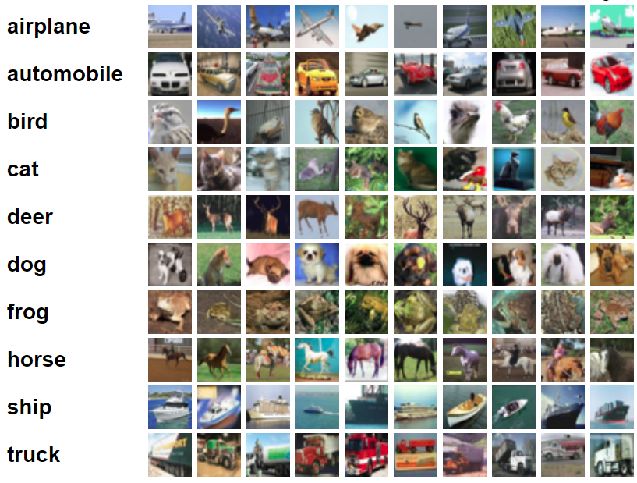
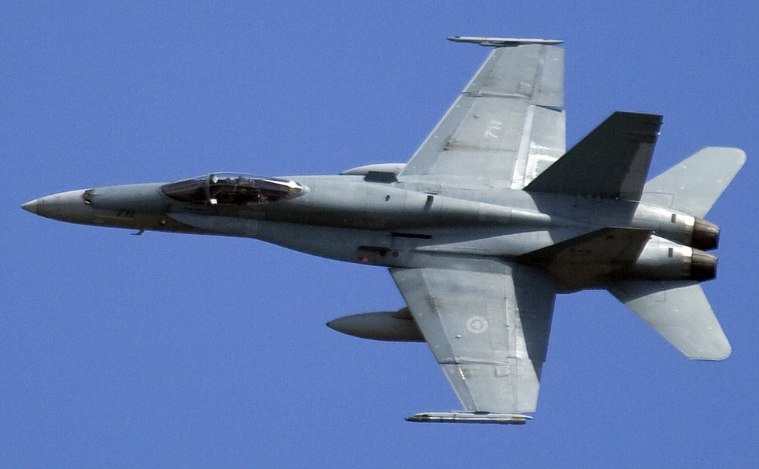
Model Training Example – Image Classification
Training data
Model Training
Infrastructure
Training Algorithm
Model
Hyperparameters
Classification: airplane
* Sample training data image from cifar10

Slide 32


Hyperparameter importance
ML / DL model performance heavily depends on hyperparameter selection
E.g. – It’s a bird, it’s a plane, it’s an image classification model…
Classification: bird
1 hidden layer
VS
Input image
Classification: airplane
2 hidden layers
* Model example for illustration only

Slide 33
Hyperparameter exploration
Search across various hyperparameter configurations
Find the configuration that results in best performance
Example Problem
Find “best” values for Number_of_layers and learning_rate
Number_of_layers – [2, 4, 8]
learning_rate – anywhere between 0 and 1
Optimize for model accuracy
Challenges
Huge search space to explore
Sparsity of good configurations
Expensive evaluation
Limited time and resources

Slide 34
Typical manual approaches for hyperparameter tuning
Dataset
Model Training
Infrastructure
Training Algorithm
Model 1
Model 2
Model 3
Hyperparameter
Values – config 1
Hyperparameter
Values – config 2
Hyperparameter
Values – config 3

Slide 35
Automated Hyperparameter Tuning in Azure ML
Automate the exploration process
Efficient use of resources
Optimize model for a specified metric
Offers control over resource budget
Apply to different models and learning domains
Training framework agnostic
Visualize all configurations in one place

Slide 36
How it works
Hyperparameter Tuning runs in Azure ML
Launch multiple parallel training runs
P nodes
(A) Generate new runs
Which parameter configuration to explore?
#1
$${run}_{1}$$
$${run}_{j}$$
???
${run}_{1}$= {learning rate=0.2, #layers=2, …}
#2
$${run}_{2}$$
$${run}_{i}$$
${run}_{2}$= {learning rate=0.5, #layers=4, …}
…
(B) Manage resource usage of active runs
How long to execute a run?
#$p$
$${run}_{p}$$
$${run}_{k}$$
${run}_{p}$= {learning rate=0.9, #layers=8, …}
Time

Slide 37
Generate new runs
{
“learning_rate”: uniform(0, 1),
“num_layers”: choice(2, 4, 8)
…
}
Sampling
algorithm
Config1= {“learning_rate”: 0.2, “num_layers”: 2, …}
Config2= {“learning_rate”: 0.5, “num_layers”: 4, …}
Config3= {“learning_rate”: 0.9, “num_layers”: 8, …}
…
Define hyperparameter search space
Supported sampling algorithms –
Grid Sampling (exhaustive search)
Random Sampling
Bayesian Optimization (‘learn’ from prior searches chances of more progress is likely, or change strategy)

Slide 38
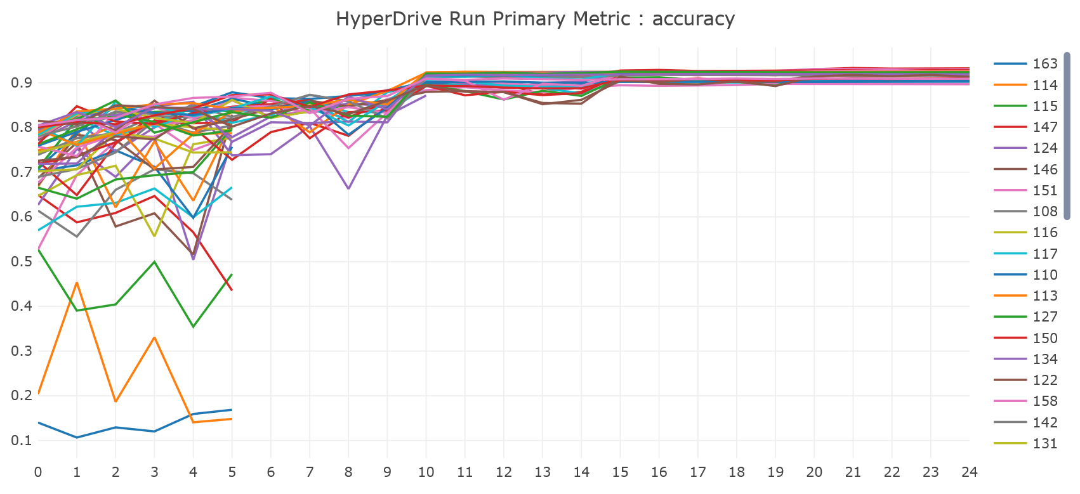
Manage Active Jobs
Evaluate training runs for specified primary metric
Early terminate poor performing training runs
Use resources to explore new configurations
Early terminate poorly
performing runs
Supported early termination algorithms –
Bandit policy (variance threshold – i.e. must be within x% of average)
Median Stopping policy (must be better than current median)
Truncation Selection policy (specified minimum)
Must use azureml api/cli to return the measurement taken

Slide 39
User inputs & system outputs
Hyperparameter Tuning Config –
Hyperparameter ranges
Optimization metric
Early Termination Policy
Budget – Time / Compute
# parallel runs
Training script
+
Training data
Recommended hyperparameter configuration & run metrics
Hyperparameter Tuning in Azure ML

Slide 40
Cancelling unproductive hyperparameter runs without being too agressive
Truncation selection cancels a given percentage of lowest performing runs at each evaluation interval.
Runs are compared based on their performance on the primary metric and the lowest X% are terminated.
It takes the following configuration parameters:
truncation_percentage: the percentage of lowest performing runs to terminate at each evaluation interval.
Specify an integer value between 1 and 99.
evaluation_interval: the frequency for applying the policy (optional parameter).
delay_evaluation: delays the first policy evaluation for a specified number of intervals
(optional parameter).

Slide 41
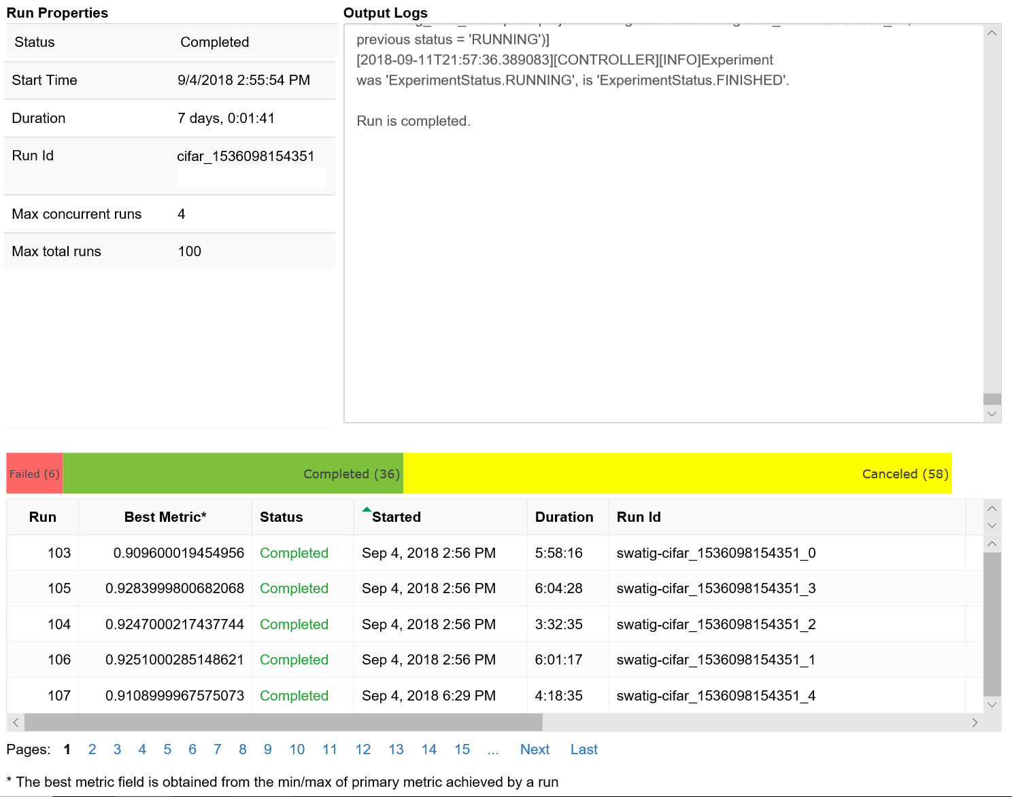
Visuals (need to run samples)

Slide 42

Early termination of a hyperparameter search

Slide 43
Many Demos https://github.com/Azure/MachineLearningNotebooks/tree/master/automl

Slide 44
Try it for free
Learn more http://aka.ms/azureml-docs
Start now https://azure.microsoft.com/free/

Slide 45
Other session on Azure ML from MicrosoftIgnite.com (also on YouTube)
Code | Title | Speakers |  |  | Time Slot
BRK2304 | AI with Azure Machine Learning services: Simplifying the data science process | Daniel Schneider | Seth Juarez |  | Tuesday 9:00 AM - 10:15 AM
BRK3206 | AI for an Intelligent Cloud and Edge: Discover, Customize, Deploy, Manage AI that can run seamlessly on the fastest cloud and edge devices | Henry Jerez | Ted Way |  | Tuesday 4:00 PM - 5:15 PM
BRK3333 | AI everywhere: Open and interoperable platform for AI with ONNX | Prasanth Pulavarthi |  |  | Tuesday 4:30 PM - 5:15 PM
BRK3332 | Model optimization covering automated ML and hyperparameter tuning | Krishna Anumalasetty | Swati Gharse | Deepak Mukunthu | Wednesday 12:30 PM - 1:45 PM
BRK3331 | AI for pros: Deep learning with PyTorch using the Azure Data Science Virtual Machine and scaling training with Azure ML | Nishank Gupta | Minna Xiao |  | Friday 10:45 AM - 12:00 PM
THR3098 | AI TechTalk: Azure Machine Learning SDK - a walkthrough | Parashar Shah |  |  | Wednesday 11:20 AM - 11:40 AM
THR3099 | AI TechTalk: Data science/deep learning VMs in Azure - your launchpad for custom AI solutions | Nishank Gupta |  |  | Thursday 2:15 PM - 2:35 PM
https://myignite.techcommunity.microsoft.com/videos

